Slide 1

Exploring Global Health Through Data: World Life Expectancy with MySQL
Created by: Syed Daniyal Ahmed Business Intelligence & Data Analyst

Slide 2
Introduction:
Life expectancy is one of the most widely used indicators to measure the overall health and development of populations across the globe.
It reflects the average number of years a person is expected to live, based on current mortality patterns.
The World Life Expectancy Project focuses on analyzing and comparing life expectancy trends across countries, regions, and demographics.
It provides insights into public health outcomes, socio-economic disparities, and policy effectiveness.
Created by: Syed Daniyal Ahmed Business Intelligence & Data Analyst

Slide 3
Overview:
The project collects and analyzes data from global organizations like WHO, UN, World Bank, and national health agencies.
Factors studied include healthcare access, lifestyle choices, income levels, education,
environmental conditions, and disease prevalence.
It aims to highlight patterns, inequalities, and progress in life expectancy across nations.
The project can be used by researchers, policymakers, NGOs, and governments to design
interventions that improve population health and longevity.
Created by: Syed Daniyal Ahmed Business Intelligence & Data Analyst

Slide 4
Objectives:
Analyze Trends: Study global, regional, and country-specific life expectancy patterns over time.
Identify Key Drivers: Pinpoint factors influencing variations in life expectancy (e.g., healthcare, poverty, epidemics, lifestyle, climate change).
Compare & Benchmark: Compare life expectancy across countries to identify high-performing nations vs. struggling ones.
Support Policy Decisions: Provide evidence-based insights to governments and health organizations for better planning.
Promote Global Equity: Highlight inequalities in life expectancy to encourage actions that reduce gaps between developed and developing regions.
Created by: Syed Daniyal Ahmed Business Intelligence & Data Analyst

Slide 5
Problem Statement:
Despite advances in medicine, technology, and living standards, there are significant disparities in life expectancy worldwide.
Some countries have an average life expectancy above 80 years, while others remain below 60 years, showing inequality.
Contributing problems include:
Unequal access to healthcare and nutrition
High rates of infectious and chronic diseases
Poverty, war, and displacement
Environmental challenges (pollution, unsafe water, climate change)
Lifestyle risks (smoking, alcohol, poor diet, inactivity)
The World Life Expectancy Project steps in to bridge this gap, providing insights that can guide targeted interventions for better global health outcomes.
Created by: Syed Daniyal Ahmed Business Intelligence & Data Analyst

Slide 6
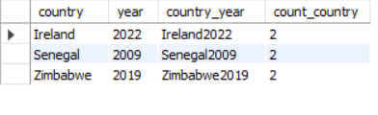
Q1: How can we identify duplicate records in the world_life_expectancy table where the same country and year combination appears more than once?
Created by: Syed Daniyal Ahmed Business Intelligence & Data Analyst

Slide 7
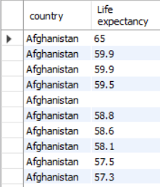
Q2: How can we retrieve the list of countries along with their life expectancy values from the world_life_expectancy table?
Created by: Syed Daniyal Ahmed Business Intelligence & Data Analyst

Slide 8
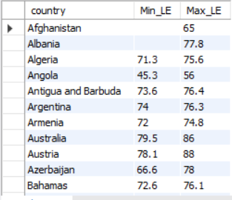
Q3: For each country, what are the minimum and maximum life expectancy values recorded in the world_life_expectancy dataset?
Created by: Syed Daniyal Ahmed Business Intelligence & Data Analyst

Slide 9
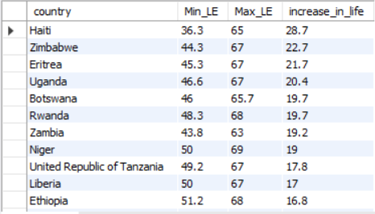
Q4: Which countries have shown the greatest increase in life expectancy over time, and by how many years has life expectancy improved in each country?
Created by: Syed Daniyal Ahmed Business Intelligence & Data Analyst

Slide 10
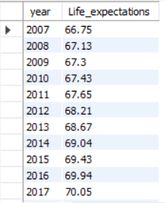
Q5: What is the average life expectancy across all countries for each year, and how has it changed over time?
Created by: Syed Daniyal Ahmed Business Intelligence & Data Analyst

Slide 11
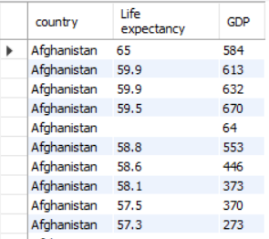
Q6: How can we retrieve the life expectancy values of country along with their corresponding GDP from the world_life_expectancy dataset?
Created by: Syed Daniyal Ahmed Business Intelligence & Data Analyst

Slide 12
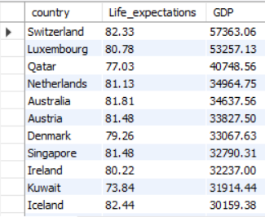
Q7: What is the average life expectancy and average GDP for each country, and how do countries rank when ordered by GDP in descending order?
Created by: Syed Daniyal Ahmed Business Intelligence & Data Analyst

Slide 13
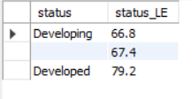
Q8: What is the average life expectancy for countries based on their development status (Developed vs. Developing)?
Created by: Syed Daniyal Ahmed Business Intelligence & Data Analyst

Slide 14
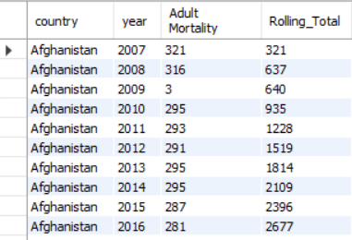
Q9: For each country, how has adult mortality accumulated year by year, and what is the rolling total across time?
Created by: Syed Daniyal Ahmed Business Intelligence & Data Analyst

Slide 15
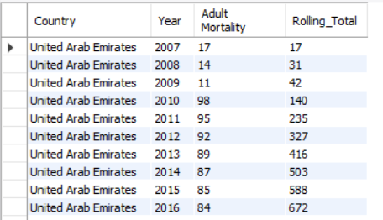
Q10: For countries whose names begin with 'United', what are their yearly adult mortality values, and how does the rolling total of adult mortality change over time within each country?
Created by: Syed Daniyal Ahmed Business Intelligence & Data Analyst

Slide 16
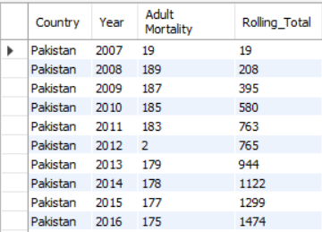
Q11: For ‘Pakistan', what are the yearly adult mortality values, and how does the rolling (cumulative) total of adult mortality progress over time?
Created by: Syed Daniyal Ahmed Business Intelligence & Data Analyst

Slide 17
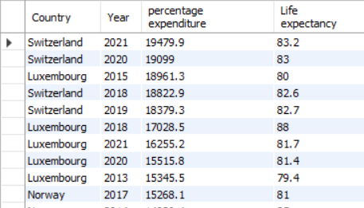
Q12: Which countries and years have the highest health percentage expenditure, and how does that relate to life expectancy?
Created by: Syed Daniyal Ahmed Business Intelligence & Data Analyst

Slide 18
Q13: Which countries and years have the highest health percentage expenditure, and how does that relate to life expectancy?
Created by: Syed Daniyal Ahmed Business Intelligence & Data Analyst

Slide 19
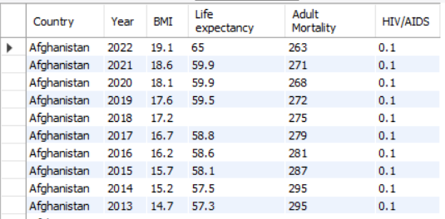
Q14: What are the values of BMI, life expectancy, adult mortality, and HIV/AIDS prevalence for each country and year in the world_life_expectancy dataset?
Created by: Syed Daniyal Ahmed Business Intelligence & Data Analyst

Slide 20
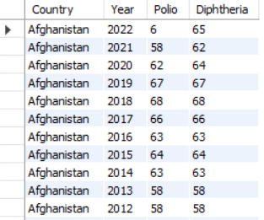
Q15: What are the Polio and Diphtheria immunization rates for each country and year, considering only records where both values are available?
Created by: Syed Daniyal Ahmed Business Intelligence & Data Analyst

Slide 21
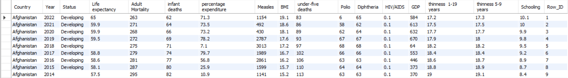
Organized Data:
Created by: Syed Daniyal Ahmed Business Intelligence & Data Analyst

Slide 22
Final Takeaways:
Global life expectancy has improved overall, but the gap between developed and developing nations remains significant.
Economic strength matters → countries with higher GDP generally have higher life expectancy, though the relationship isn’t perfectly linear.
Health expenditure plays a role, but spending more doesn’t always guarantee longer lives efficiency and access to healthcare matter too.
Adult mortality and HIV/AIDS prevalence are critical negative drivers, pulling life expectancy down in many low-income countries.
Immunization rates (Polio & Diphtheria) show a positive association with better life expectancy, emphasizing the importance of preventive healthcare.
BMI and lifestyle indicators highlight growing risks in certain regions (obesity vs malnutrition), showing that both under- and over-nutrition are challenges.
Created by: Syed Daniyal Ahmed Business Intelligence & Data Analyst

